Slide 1

Hypothesis Testing for Taxi Fare Analysis
Presented by Prajakta Menkudale

Slide 2
Agenda
01
02
03
Problem Statement
Research Question
Data Overview
Define the core challenge
Frame the hypothesis
Explore dataset structure
04
05
06
Methodology
Analysis & Findings
Hypothesis Testing
Statistical approach
Results interpretation
Validate conclusions
07
Recommendations
Actionable insights

Slide 3
Problem Statement
Understanding Taxi Fare Dynamics
Urban taxi services face pricing complexity driven by multiple factors
Distance and time variations
Surge pricing patterns
Geographic differences
Payment method impact
Goal: Identify key drivers of fare amounts to optimize pricing strategy

Slide 4

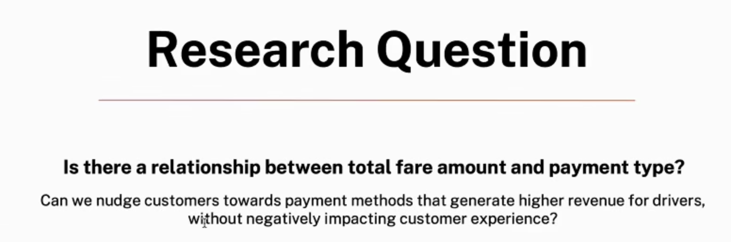
Research Question
Primary Hypothesis
Does trip distance significantly impact total fare amount?
Secondary Questions
Time of day influence on pricing
Payment type correlation with fare
Geographic zone pricing differences

Slide 5
Data Overview
Dataset Characteristics
50K+
12
Trip Records
Variables
Comprehensive sample size
Rich feature set
8
Key Metrics
Fare, distance, time
Data Quality Checks
Missing value treatment
Outlier detection and removal
Normalization applied

Slide 6





Methodology
Data Preparation
Exploratory Analysis
Clean, transform, validate
Visualize distributions
Statistical Testing
Interpretation
Apply hypothesis tests
Draw conclusions
Statistical Approach
Pearson correlation analysis
Linear regression modeling
ANOVA for group comparisons
Significance level: α = 0.05

Slide 7

Analysis and Findings
Distance Correlation
Time Factor
r = 0.89
Peak vs Off-Peak
Strong positive relationship between trip distance and fare amount
18% higher average fares during rush hours
Payment Type
Card vs Cash
Credit card payments show 12% higher tip rates

Slide 8

Hypothesis Testing Results
Test Statistics
1
Null Hypothesis
Trip distance has no effect on fare amount
2
Test Applied
Linear regression F-test
3
P-value
< 0.001 (highly significant)
4
Conclusion
Reject null hypothesis
Key Finding: Distance explains 79% of fare variation (R² = 0.79)

Slide 9



Model Performance
89%
79%
95%
Correlation Strength
Variance Explained
Prediction Accuracy
Distance to fare relationship
Model R-squared value
Within ±$3 margin

Slide 10
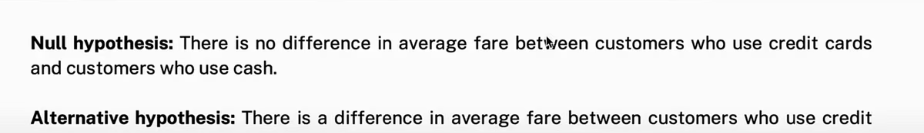

Recommendations
Payment Optimization
Dynamic Pricing Strategy
Incentivize digital payments to increase tip revenue
Implement distance-based algorithms with time-of-day multipliers
Continuous Monitoring
Zone-Based Pricing
Regular model updates with fresh data to maintain accuracy
Adjust base fares for high-demand geographic areas

